Slide 1
ADC INTERFACING

Slide 2
Why we need adc
In embedded systems microcontrollers needs to take analog input. Most of the sensors & transducers such as temperature, humidity, pressure, are analog. For interfacing these sensors to microcontrollers we require to convert the analog output of these sensors to digital so that the controller can read it.
Some microcontrollers have built-in Analog to Digital Convertor (ADC) so there is no need for external ADC. For microcontrollers that don’t have internal ADC external ADC is used.
8051 doesn’t have an inbuilt ADC. So we have to use external ADC. There are many ADCs available.
ADC 0804 - In ADC0804 we can give only one analog input.
ADC 0808 : we can give 8 analog inputs

Slide 3
ADC0808
ADC0808 is an 8 bit analog to digital converter with eight input analog channels, i.e., it can take eight different analog inputs.
The input which is to be converted to digital form can be selected by using three address lines.
The voltage reference can be set using the Vref+ and Vref- pins. The step size is decided based on the set reference value. Step size is the change in analog input to cause a unit change in the output of ADC.
The default step size is 19.53mV corresponding to 5V reference voltage. A
DC0808 needs an external clock to operate, unlike ADC0804 which has an internal clock.
The ADC needs some specific control signals for its operations like start conversion and brings data to output pins.
When the conversion is complete the EOC pins go low to indicate the end of conversion and data ready to be picked up.

Slide 4
Features
Easy interface to all microprocessors
Operates ratio metrically or with 5 V DC or analog span adjusted voltage reference
No zero or full-scale adjust required
8-channel multiplexer with address logic
0V to 5V input range with single 5V power supply
Outputs meet TTL voltage level specifications
Standard hermetic or molded 28-pin DIP package
28-pin molded chip carrier package

Slide 5
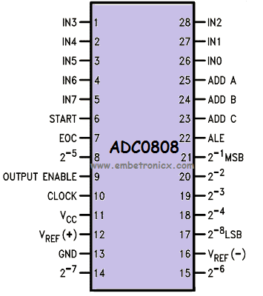
Pin Diagram

Slide 6
Calculating Step Size
ADC 0808 is an 8 bit ADC i.e. it divides the voltage applied at Vref+ & Vref- into 28 i.e. 256 steps.
Step Size = (Vref+ - Vref-)/256
Suppose Vref+ is connected to Vcc i.e. 5V & Vref- is connected to the Gnd then the step size will be
Step size= (5 - 0)/256= 19.53 mv

Slide 7
How to use the ADC0808?
Start
Select the channel.
A Low – High transition on ALE to latch in the address.
A Low – High transition on Start to reset the ADC’s SAR.
A High – Low transition on ALE.
A High – Low transition on start to start the conversion.
Wait for the End of cycle (EOC) pin to become high.
Make Output Enable pin High.
Take Data from the ADC’s output
Make Output Enable pin Low.
Stop

